Slide 1
Cryptography Survey of Transposition Cipher Method
Dhaval Chauhan
MIS 534
Information Security Management

Slide 2
Outline
Cryptography
01
Symmetric Encryption
02
Asymmetric Encryption
03
Traditional ciphers
04
Substitution & Transposition
05
Rail Fence Cipher & Route Cipher
06
Columnar & Double Transposition
07
Conclusion
08

Slide 3
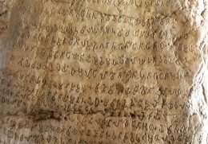
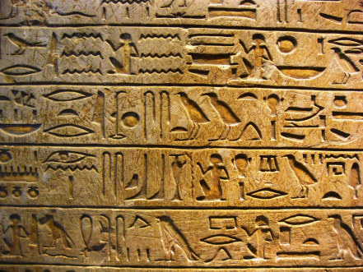
Cryptography
“ Encrypt data before sending so no one can understand what is meaning of this random alphabets or numbers”
Used from Egyptian ages – Non standard hieroglyphs
https://4815162342execute.wordpress.com/lost-themes/hieroglyphs/
http://www.amarujala.com/dehradun-city/Dehradun-66300-11

Slide 4
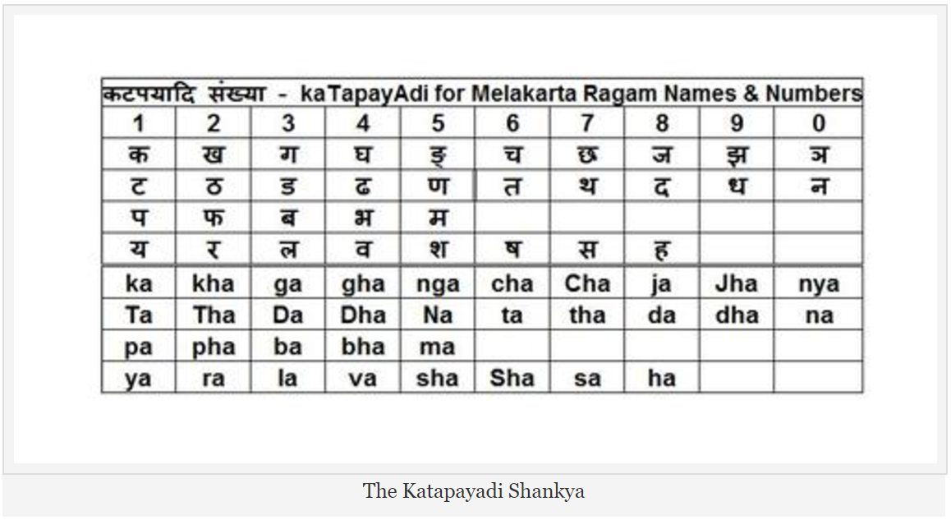
Cryptography
The “ka-ta-pa-ya-di” rule used by ancient Indian mathematicians and grammarians is a tool to map names to numbers.
“gopi bhagya madhuvrata
srngiso dadhi sandhiga
khala jivita khatava
gala hala rasandara”
31415926535897932384626433832792
https://mysteriesexplored.wordpress.com/2011/08/24/amazing-encryption-technology-in-ancient-india-the-katapayadi-shankya/

Slide 5
Symmetric Encryption
Private key encryption
Mathematical operations
Shared key for sender and receiver
Challenges
How to transfer that key to receiver
What if key is already intercept by third person
Change key frequently

Slide 6
Asymmetric Encryption
Separate key for encryption and decryption
Public key - used by sender to encrypt data
Secret key – used by receiver to decrypt data
Challenges
Larger key size
Key management

Slide 7
Traditional ciphers
Substitution cipher
Transposition cipher
Plain alphabet: abcdefghijklmnopqrstuvwxyz
Cipher alphabet: badcfehgjilknmporqtsvuxwzy
Plain text: Cryptography is must
Cipher text: Dqosphqbogz jt nvts

Slide 8
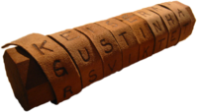
Rail Fence Cipher
Plaintext is written downwards across successive ‘rails’ of an imaginary ‘fence’.
Plain text: ‘UNCW CSIS PROGRAM’
RAIL 1 | U | W | I | R | R
RAIL 2 | N | C | S | O | A
RAIL 3 | C | S | P | G | M
Read characters along the rail from left to right
Ciphered text is “UWIRRNCSOACSPGM”.
Used by the ancient Greeks in the scytale

Slide 9
Route Cipher
Key decides how to follow route while reading ciphertext from block created with plaintext.
W | H | E | N | N
N | O | T | H | I
N | H | N | I | S
N | G | O | I | N
G | N | R | I | G
H | T | N | G | O
N | T | E | F | T
Route: top to bottom
Cipher Text: WNNNGHNHOGGNTLETNORNENHIIIGFNISNGOT
Route: spiraling inward
Cipher Text: NHGNNNWHENNISNGOTFELTNGGOTHIIIGNRON
Used by the Union forces during the American Civil War

Slide 10
Column Transposition
Decide Key Length
Plain Text: THIS IS MOST SECRET MESSAGE DO NOT TRY TO DECODE IT
Cipher Text: STTGTDIISEAOOETMCSOYTISMETETSEEDRCDHORSNTD
3 | 6 | 2 | 1 | 4 | 5
T | H | I | S | I | S
M | O | S | T | S | E
C | R | E | T | M | E
S | S | A | G | E | D
O | N | O | T | T | R
Y | T | O | D | E | C
O | D | E | I | T
1 | 2 | 3 | 4 | 5 | 6
S | I | T | I | S | H
T | S | M | S | E | O
T | E | C | M | E | R
G | A | S | E | D | S
T | O | O | T | R | N
D | O | Y | E | C | T
I | E | O | T | D

Slide 11
Double Transposition
A columnar transposition is less secure. Because if attacker determines column length by observing multiple encrypted messages, He can try different anagrams.
So to enhance security, columnar transposition can be applied twice.
Both key can be same or different
During World War 2, Allies and the Axis, both used this algorithm. And it was a success for both.
Plain Text: LETS GO FOR SKYDIVING AFTER MIS PRESENTATION
Key 1: DHAVAL
Key 2: CHAUHAN

Slide 12
Double Transposition
3 | 4 | 1 | 6 | 2 | 5
D | H | A | V | A | L
L | E | T | S | G | O
F | O | R | S | K | Y
D | I | V | I | N | G
A | F | T | E | R | M
I | S | P | R | E | S
E | N | T | S | T | I
O | N
D | H | A | V | A | L
L | E | T | S | G | O
F | O | R | S | K | Y
D | I | V | I | N | G
A | F | T | E | R | M
I | S | P | R | E | S
E | N | T | S | T | I
O | N
Read the cipher back by column , starting from lowest number column
Cipher Text: ATRVTPT AGKNRET DLFDAIEO HEOIFSNN LOYGMSI VSSIERS

Slide 13
Double Transposition
3 | 4 | 1 | 7 | 5 | 2 | 6
C | H | A | U | H | A | N
A | T | R | V | T | P | T
A | G | K | N | R | E | T
D | L | F | D | A | I | W
O | H | E | O | I | F | S
N | N | L | O | G | M | S
I | V | S | S | I | E | R
S
After reading it again from column:
cipher text:
ARKFELS APEIFME CAADONIS HTGLHNV HTRAIGI NTTWSSR UVNDOOS

Slide 14
Conclusion
Lacks stronger encryption
Keeps occurrences of individual characters of plain text unchanged
Proper anagrams can decrypt cipher text
Jumbled character search in dictionary to find words
At the time of world war, this method was useful
But now with the help of faster computers anagrams search and test is faster

Slide 15
Questions ???

